Slide 1



Machine Learning Challenge: Predicting US Carbon Emissions
Team Oxy
Alex Lach, Reservoir Engineer
Markus Emsermann, Mathematical Scientist
Priyank Dwivedi, Reservoir Engineer
June 2022

Slide 2
Outline
Background
Exploratory Data Analysis
Modeling Approach and Results
Conclusions

Slide 3
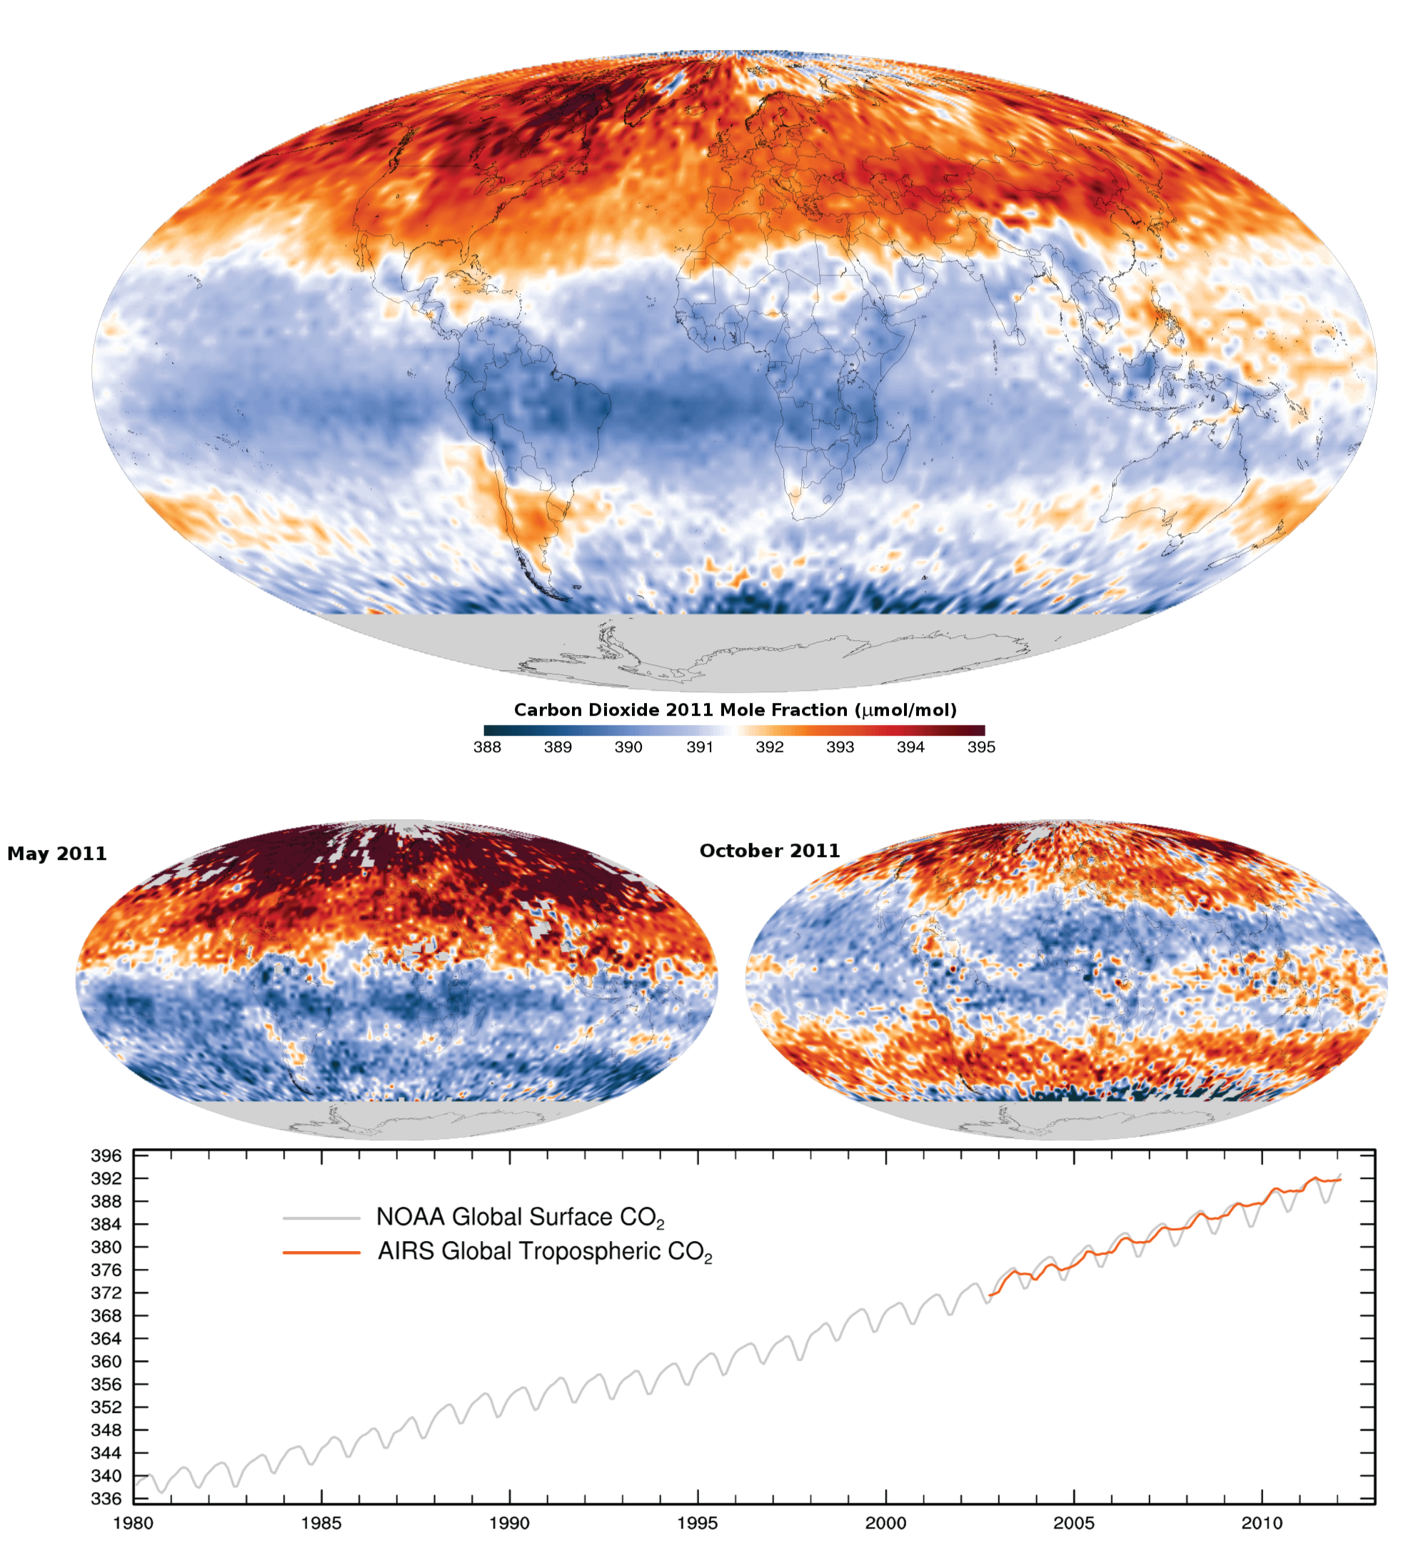
Background
Carbon Capture, Utilization, and Storage (CCUS) technology is growing more important
Predicted future carbon emissions could drive CCUS project selection
Predictions could have a major impact on point source capture projects, such as working with power plants, factory farms, or landfills
Predictions should have no influence on Direct Air Capture (DAC) projects because atmospheric mixing dominates local emissions
This challenge directs us to predict monthly carbon emissions in the United States for distinct locations
We are given emissions data for the locations from January 2000 through December 2019
Data was sourced from the Copernicus Atmosphere Monitoring Service
Local CO₂ concentrations vary by less than 2% due to the strong influence of atmospheric mixing

Slide 4
Exploratory data analysis

Slide 5
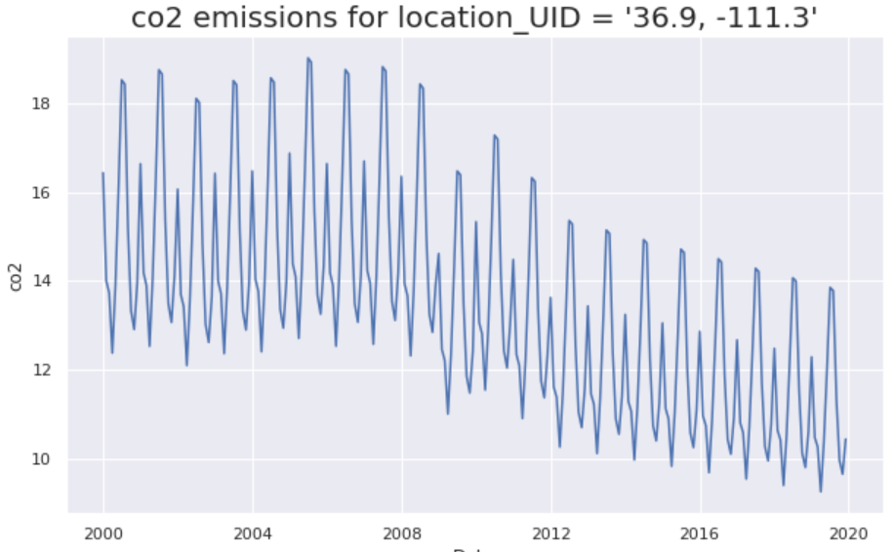
Data Analysis
We are given CO₂ emissions data for 153 locations provided spread across US, US-Canada border and US-Mexico border
Looking at one example location, we can see a “heartbeat” pattern indicating seasonality to the data
We can also see a larger underlying annual trend
It could be helpful to model these separately, so we will explore them more
CO₂ Emissions for an Example Location ‘36.9, -111.3’

Slide 6
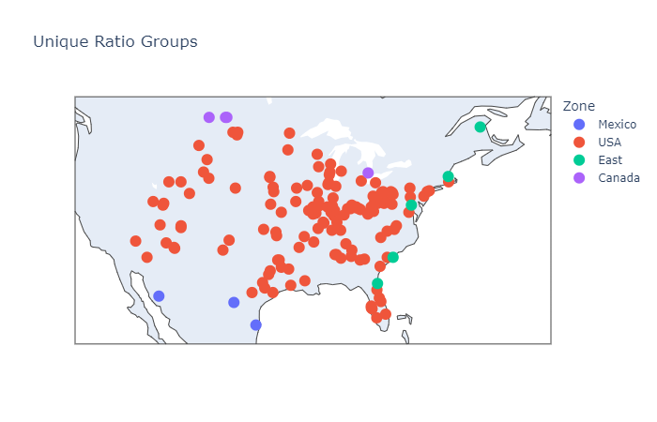
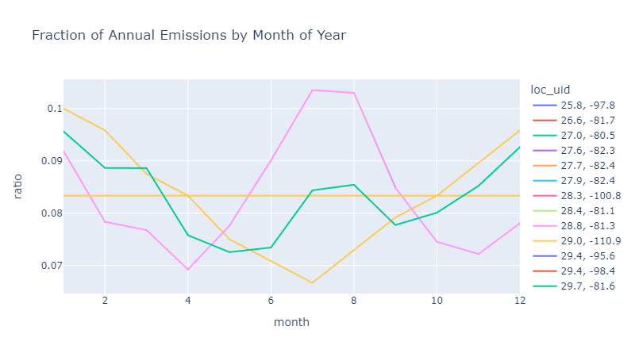
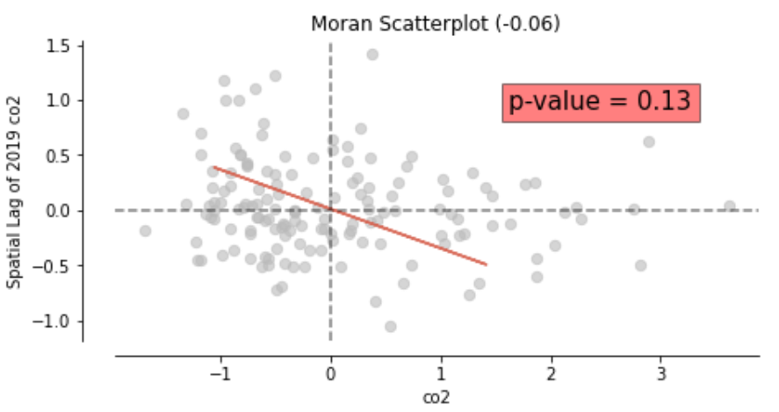
Spatial and Seasonality Analysis
We would expect to see geographic seasonality in CO₂ emissions, with summer usage higher in the south, and winter usage higher in the north (Erickson 2008)
However, in our data we found no significant spatial autocorrelation to emissions (Moran’s I statistic = -0.06, p-value = 0.13)
To model seasonality, we divide monthly emissions by annual emissions for each location
When looking at seasonality, we found that all locations had one of four distinct seasonality patterns
When we map these four patterns, we see a clear geographic trend. The seasonality for an area is dependent on its location
The consistency of the seasonality suggests that the ratio of monthly to annual emissions in our training data is itself derived from a model
Erickson 2008 - https://agupubs.onlinelibrary.wiley.com/doi/pdf/10.1029/2007JG000435
Notes:
Perhaps one seasonality model is used for Mexico, one for the US, one for Canada, and one for the Atlantic Ocean

Slide 7
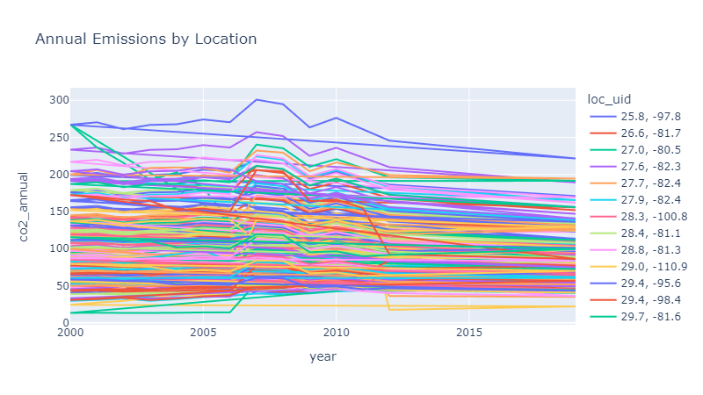
Annual Trend
From the previous slide, we know how to predict monthly emissions from annual emissions
Now our task is to predict annual emissions
When we plot annual emissions for all locations, there seems to be a consistent linear trend starting in 2012
In fact, when we limit ourselves to post-2012 data, a linear model achieves a perfect fit

Slide 8
Modeling Approach

Slide 9
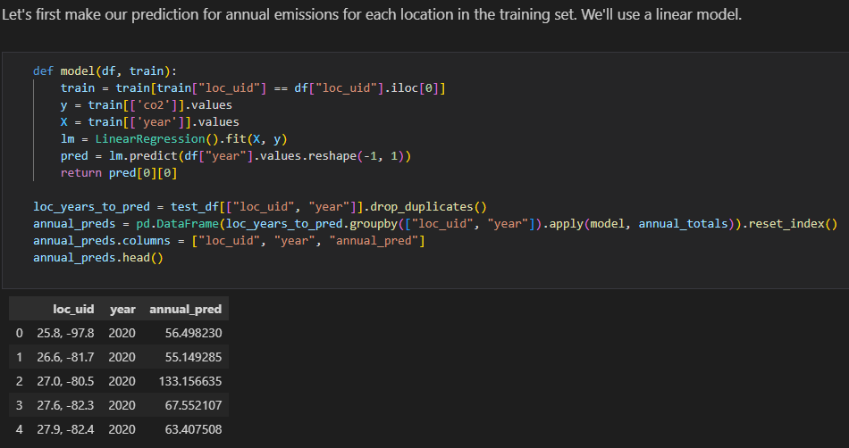
Submitted Model
We can combine our seasonality model with our annual model to create forecasts
Our approach for the test data:
Predict annual emissions for the required year using the linear model
Based on the geographic location, assign a “zone” and monthly ratio
Multiply the predicted annual emissions by the monthly ratio to get monthly emissions
This approach achieved a perfect zero RMSE
Python Notebook Code Modeling Annual Emissions

Slide 10
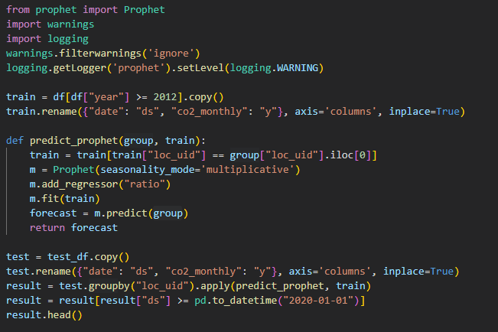
Alternative modeling approaches
Occam’s razor suggests that the simplest modeling approach should be preferred
This might lead us to choose our simple linear + seasonality model
Nonetheless, we tried several other modeling approaches
Prophet is a model that excels at forecasting time-series data, especially with the consideration of seasonality
Prophet achieved an RMSE of 0.00187
Other approaches, such as an RNN (Recurrent Neural Network), ARIMA model, and XGBoost achieved worse results
Python Notebook Using Prophet Model

Slide 11
Conclusions

Slide 12

Conclusions
This exercise demonstrated the effectiveness of data exploration
Through data exploration, we discovered key insights: an underlying geographic seasonality model and an annual linear trend since 2012
Oftentimes a complicated model (deep neural network or ensemble model) can find an underlying trend like this on its own
However instead of naively throwing a big model at a problem, we gained a deep understanding of the data and used that to drive our solution
“Everything should be as simple as it can be, but not simpler” – Albert Einstein
Sometimes the simple approach is best
Notes:
But a complicated model sacrifices interpretability

Slide 13

Closing
This challenge was a great learning experience for our team
In the future we would be interested in exploring breaking out CO₂ emissions by source
We would like to thank the SPE GCS Data Analytics Study Group for hosting this competition
We also specifically thank the organizers, Sri Poludasu and Neila Mazula, for their effort putting this together
Finally, we thank Shell for making the Xeek platform available for the event

